Slide 1
IMPORTANCE PERFORMANCE ANALYSIS PRESENTATION
University of Alabama-Huntsville
By Misheck Malangano

Slide 2

UNIVERSITY OF ALABAMA- HUNTSVILLE
QUICK FACTS
Located in Huntsville, Alabama.
89 Degrees offered
9237 Total Student Enrollment
48 Countries of Origin.

Slide 3
INTRODUCTION/BACKGROUND
The data is based on the Importance and Performance of University of Alabama-Huntsville.
The data is based off a group of 87 survey Participants who attend University of Alabama-Huntsville.

Slide 4

CHART DATA
From the data, there are two different ways we will be evaluating Student Importance and Performance at University of Alabama-Huntsville.

Slide 5
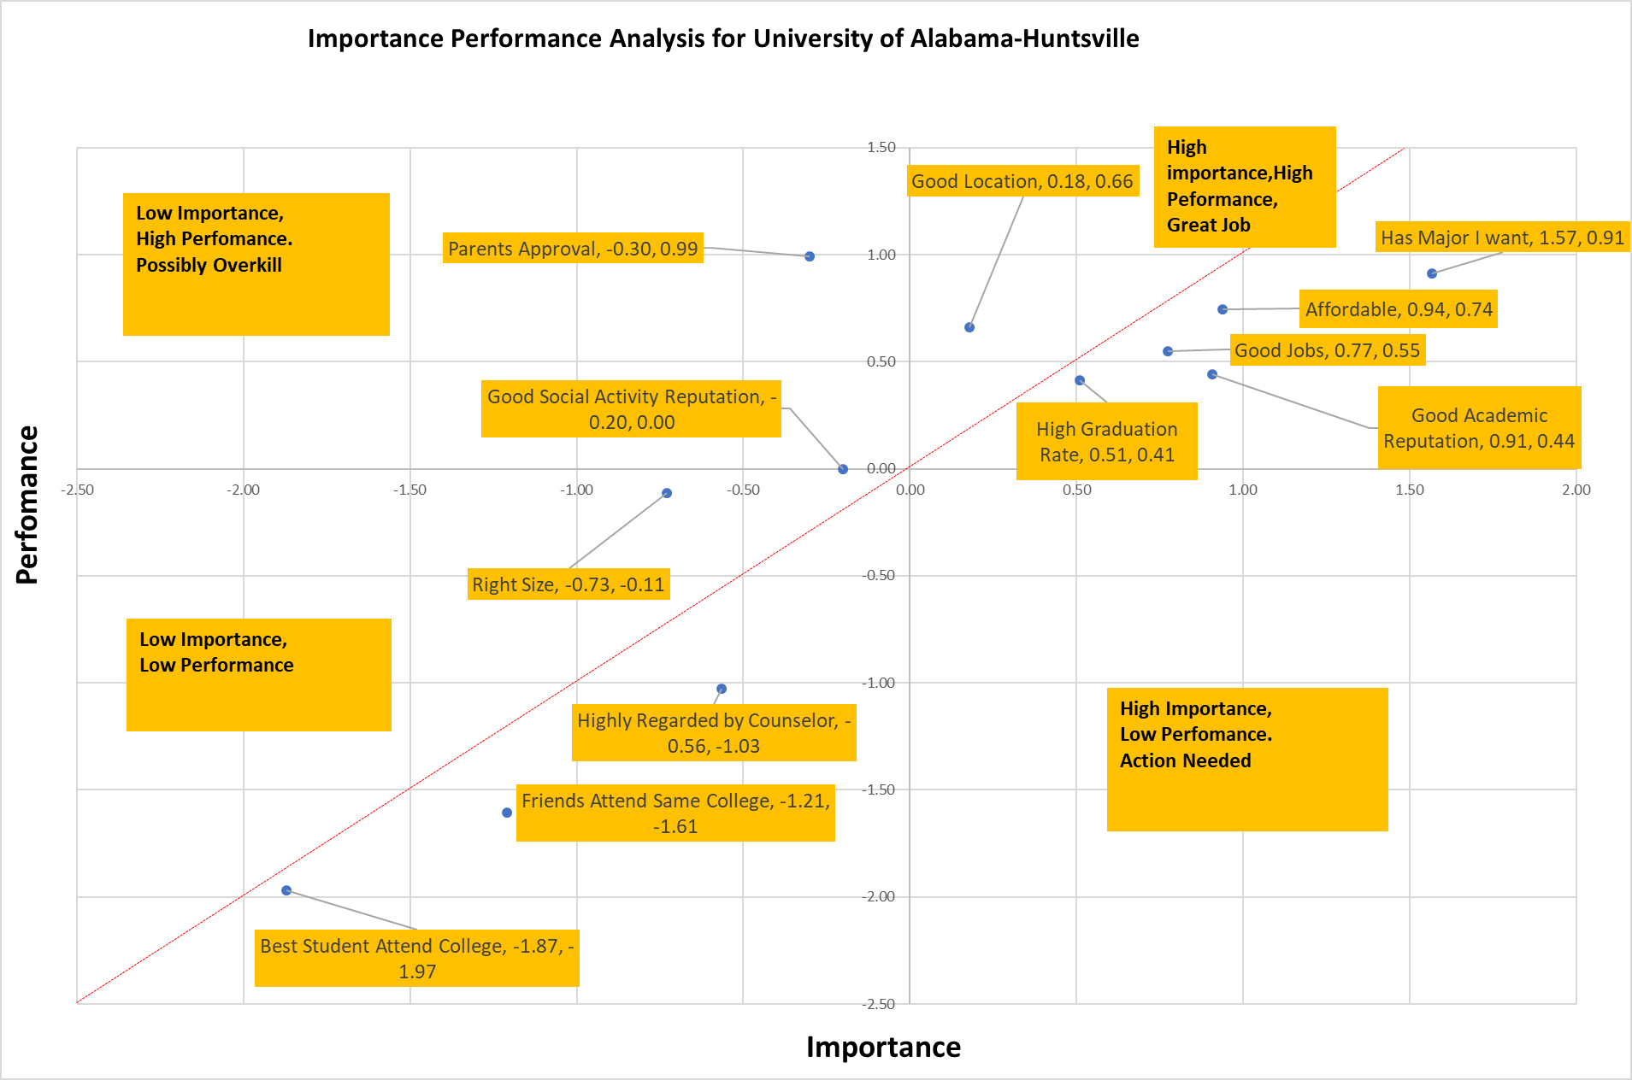
QUADRANTS

Slide 6
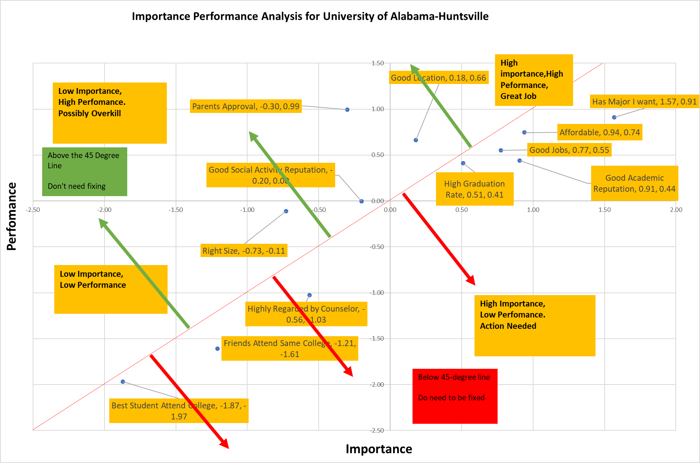
45-Degree Line

Slide 7

Our focus will be on the University of Alabama- Huntsville Data

Slide 8
AREAS DOING GREAT
Good Location
Parents Approval
Good Social Reputation

Slide 9
AREAS TO IMPROVE
Good academic Reputation
Affordability
Graduates getting good jobs
High Graduation Rate
Has the Major the Student Want

Slide 10

EVERYTHING IN BETWEEN
Right size

Slide 11

CONCLUSION
In order to Improve, University of Alabama- Huntsville must
Address Certain area with High Importance and High Performance

Slide 12
FINAL RECOMMENDATIONS
Making tuition affordable to more students.
scholarships
Assistantships
Grants
Improve number of graduating students.
Offer peer mentorship programs to struggling students
Improve on enrollment by partnering with with different Universities and agents.
Introducing more academic programs.
Improve in their Partnerships to gain good reputation.
partnering with local schools in events.
Getting involved in social events , sporting events and business events around the community.

Slide 13
THANK YOU

